Slide 1
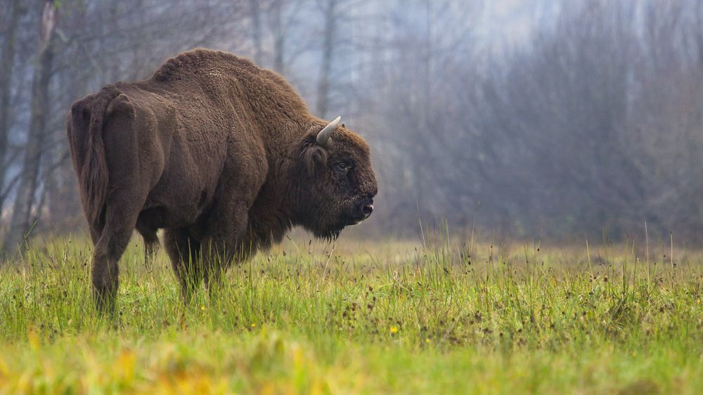
Title: American Buffalo (Bison) Population Levels from 2002 to 2017
Trends and Policy Impacts
Authors: Kyle Froisland and Saimun Nahar Saki
Course: ECNS 560 Term Project
K

Slide 2
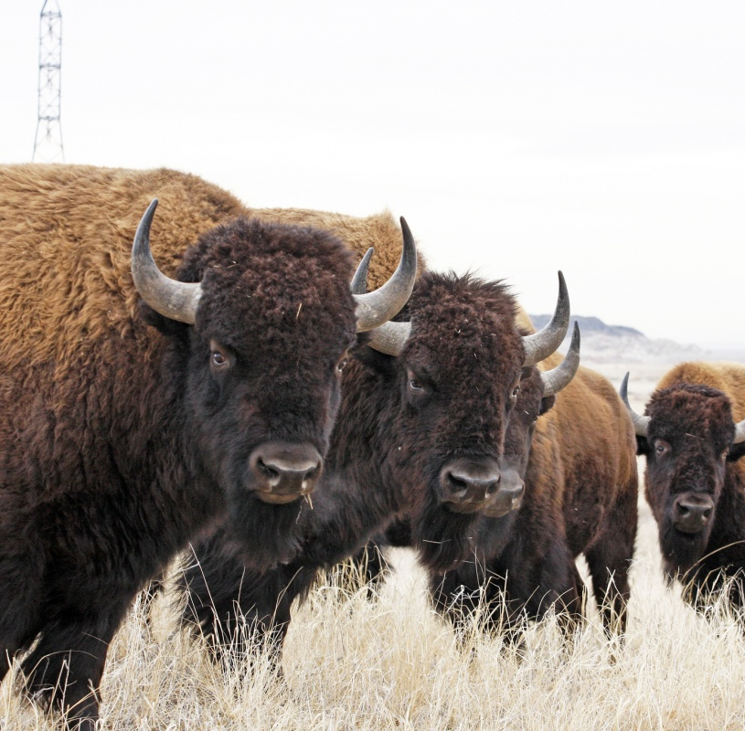
Introduction
Brief History: Bison populations declined to near extinction in the late 19th century but recovered significantly by the mid-20th century.
Significance: As the U.S. national mammal, Bison hold ecological, cultural, and historical importance, especially for Native American heritage.
S

Slide 3
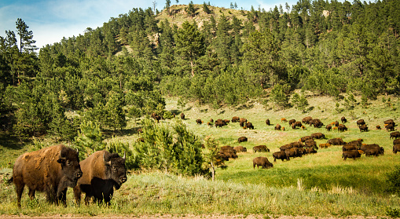
Motivation
Current Challenges:
Agricultural and ranching pressures crowd out bison domestication.
Urban expansion and homesteading reduce grazing land.
Cultural Significance:
National mammal of the U.S., vital to Native American heritage.
Policy Implications:
Need for conservation efforts, regulations, and incentives to sustain bison populations.
S

Slide 4
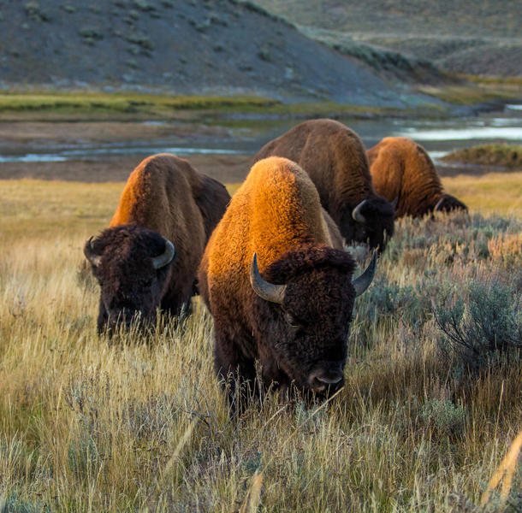
Data Sources
Bison Population Data: ArcGIS (2002–2017).
Variables: Population, Number of Operations (state/county level).
USGS Bison Habitat Map: Spatial data on ranges and habitats.
Hunting License Data: TRACS (1958–2024).
Variables: Paid License Holders, Resident/Non-Resident Licenses, Cost.
Public/Private Land Data: Census percentages by state.
GIS Canadian Boundary Data: Proximity analysis
K

Slide 5
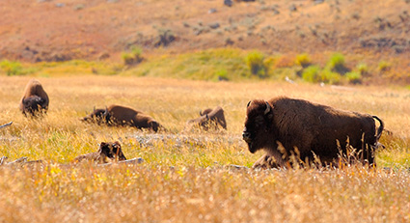
Data Processing
Bison Population Data:
Pivoted by year; cleaned strings (e.g., removed “bison_census”).
Aggregated to state level for merging.
Hunting Data:
Renamed columns; filtered for years (2002–2017); converted years to numeric.
Merged Dataset:
Left join on state/year for population and hunting data.
Spatial Data Integration
Habitat Data: Identified significant bison states.
Range Data: Focused on key grazing areas (e.g., Montana, Wyoming, Idaho).
Canadian Boundary Data: Used for proximity/latitude analysis.
Study Focus:
Key States: States with significant bison populations and habitats.
Derived Variable: Percent change in population (2002–2017).
Exclusions: Minimal bison population states excluded.
K
Notes:
Focused on Great Plains in order to avoid skewing our trends with low to no population states. Will discuss utilization of each dataset further on, but our dependent variable comes from bison population data.

Slide 6
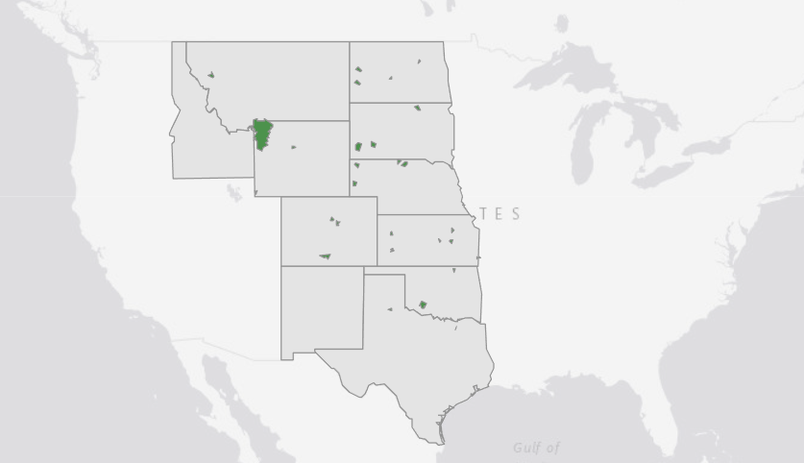
Bison Habitats Map
Bison Habitats:
Refined the subset of states focusing on areas with significant habitat and population data.
Included states with low bison populations but large habitats (e.g., Montana, Wyoming, Idaho).
Datasets:
Census Cartographic Boundary Dataset for U.S. states.
Canadian Open Source Boundary Data to analyze spatial relationships (e.g., distance from Canada).
S

Slide 7
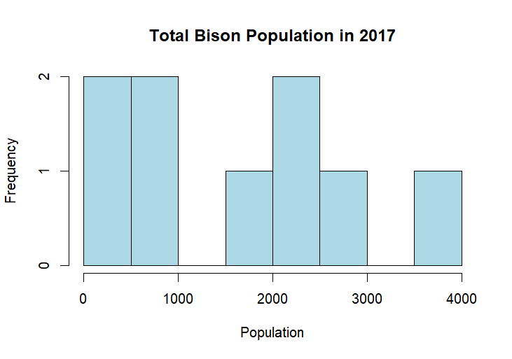
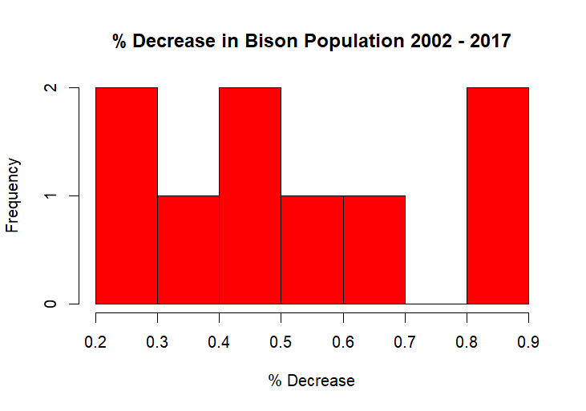
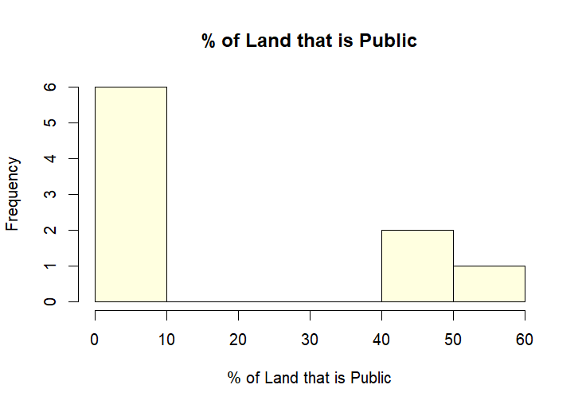
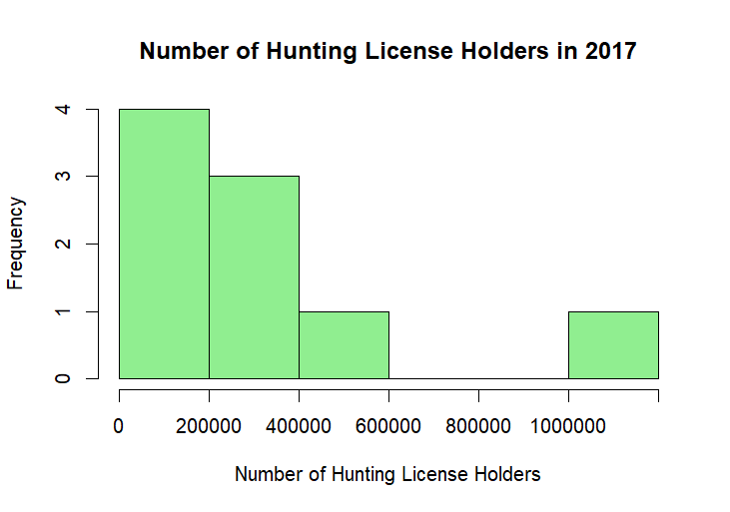
Initial Single Variable Histograms
S

Slide 8
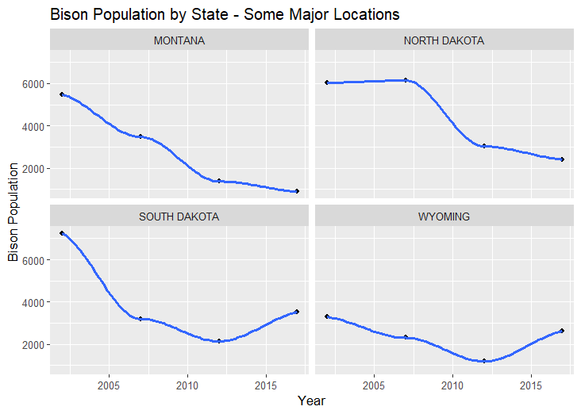
Bison Population Trends by State (2002–2017)
State-Level Trends
Key States Analyzed:
Montana, North Dakota, South Dakota, Wyoming.
Observations:
General downward trend in bison population across all states.
Variations between states:
Montana: Consistent decline in population.
North Dakota: Steady population, then a sharp drop.
South Dakota: Slight growth after a decline.
Wyoming: Shows some recovery after an initial drop.
K
Notes:
Examined all states, but selected these in order to demonstrate the heterogeneity in population trends.

Slide 9
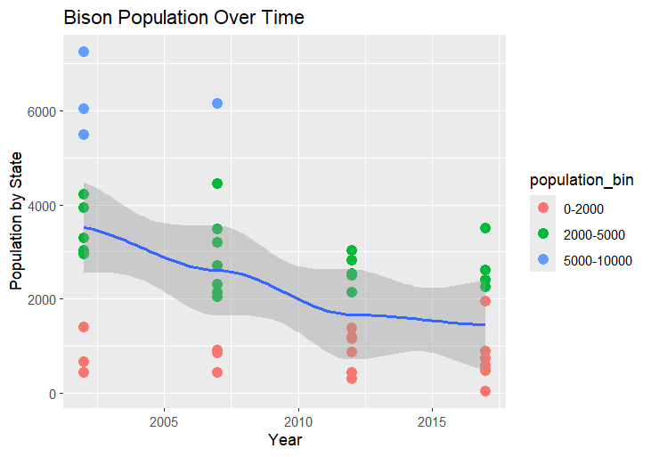
Aggregate Bison Population Trends
Bison Population Over Time
Key Insights:
The number of states with high bison populations (5,000–10,000) has significantly decreased from 2002 to 2017 (blue dots).
States with medium populations (2,000–5,000) also decline, but less dramatically (green dots).
Low population states (0–2,000) become more common (red dots), indicating a widespread reduction in herd sizes.
Aggregate trendline reflects a steady decline in bison populations across the analyzed states.
K

Slide 10
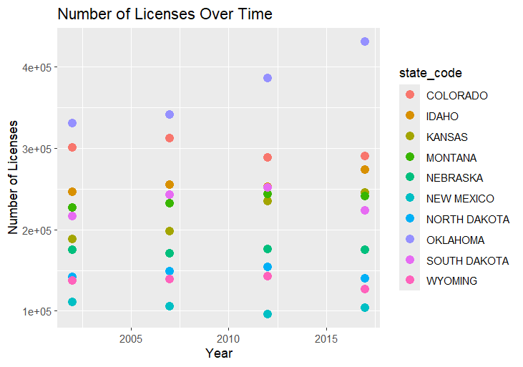
Hunting Licenses Over Time
Focus:
Examined trends in the number of hunting licenses issued over time in the Great Plains states.
Texas was excluded from the graph due to extreme values affecting the y-axis scale.
State-Specific Trends:
Fluctuations in the number of licenses across states, but no consistent trends observed across the region.
Correlation:
There is no clear correlation between hunting license counts and bison population trends.
Hunting license numbers increase or decrease independently of bison population changes.
K

Slide 11
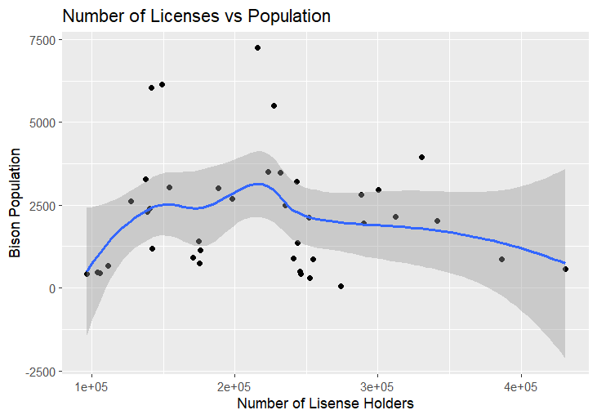
Hunting Licenses vs. Bison Population
Analysis:
Scatterplot evaluates the relationship between the number of hunting license holders and bison populations across states.
Blue trendline with a shaded confidence interval illustrates overall trends.
Key Insights:
No clear or strong correlation observed between hunting licenses and bison population.
Variability suggests other factors might influence bison population changes independently of hunting activity.
K

Slide 12
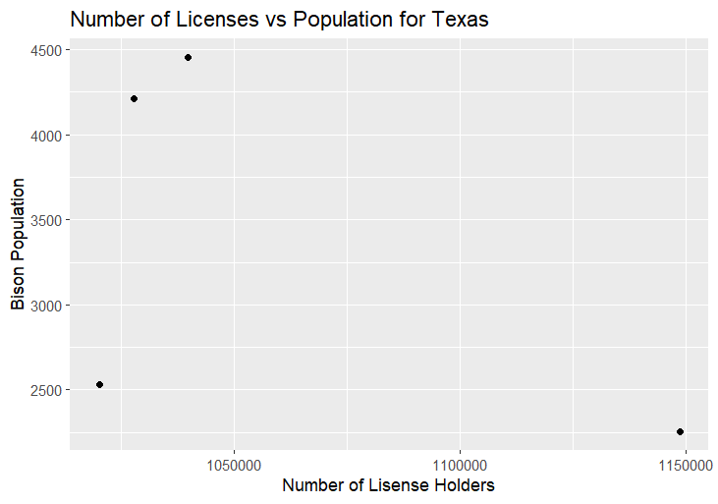
Hunting Licenses vs. Bison Population in Texas
Focus:
Evaluated the relationship between the number of hunting licenses and bison population trends in Texas.
Key Observations:
Texas shows an upward trend in hunting licenses from 2012 to 2017.
Minimal correlation observed between the increase in licenses and bison population changes.
S

Slide 13
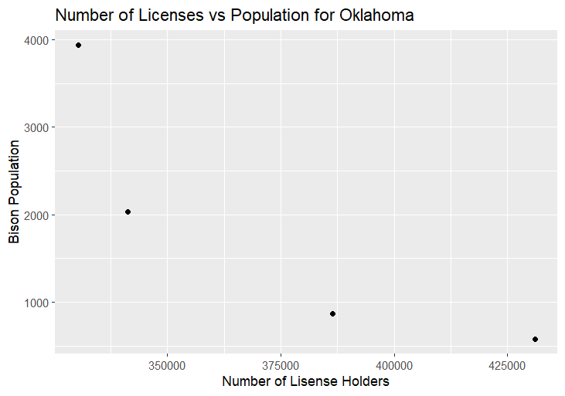
Hunting Licenses vs. Bison Population in Oklahoma
Focus:
Investigated the relationship between the number of hunting licenses and bison population in Oklahoma.
Key Observations:
Oklahoma demonstrates a negative relationship between hunting licenses and bison population.
However, causality cannot be established from this data alone.
S

Slide 14
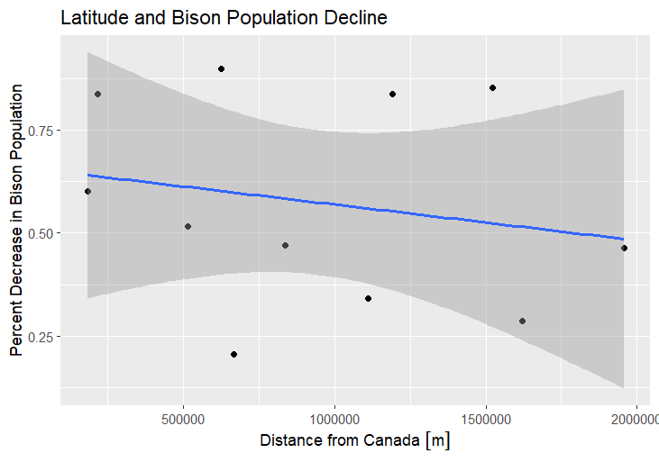
Latitude and Bison Population Decline
Focus:
Investigated the relationship between the distance from Canada (latitude) and the percent decrease in bison populations.
Key Observations:
Percent change instead of total population levels was analyzed to control for differences in state bison population capacities.
No significant linear relationship was observed between latitude and percent decline in bison populations.
K

Slide 15
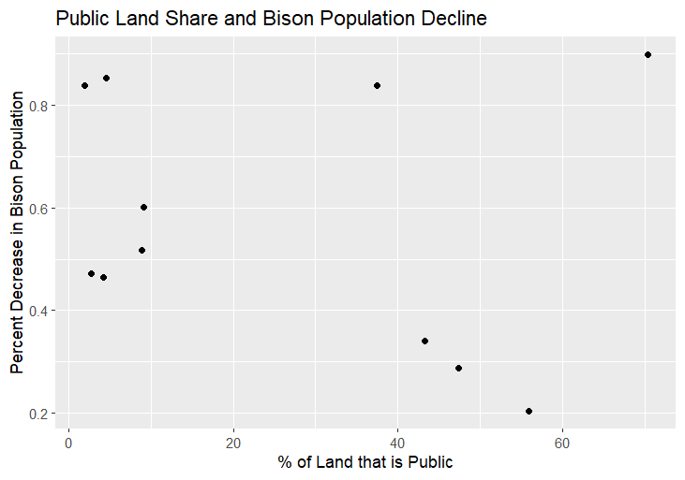
Public Land Share and Bison Population Decline
Analysis:
Investigated the relationship between the percentage of public land in each state and the percent decrease in bison populations.
Key Observations:
Initial data plot shows no clear correlation.
Outliers identified (Idaho and Montana) with high public land share and large bison population declines.
K

Slide 16
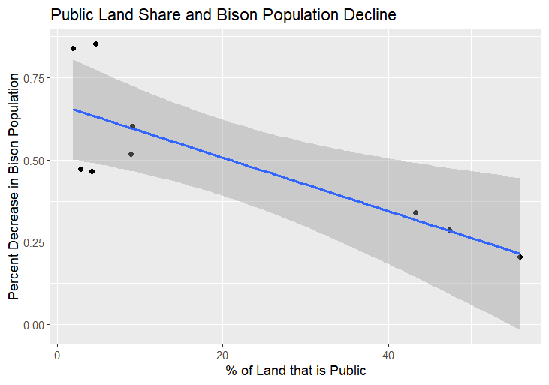
Adjusted Public Land Share and Bison Population Decline
Refined Analysis
Focus:
Removed outliers (Idaho and Montana) to account for unique exogenous impacts affecting these states.
Plotted a linear regression to better understand the relationship between public land share and bison population decline.
Key Insights:
Statistical Significance:
A 1% increase in public land share is associated with a 0.008% lower decline rate in bison population between 2002 and 2017.
Results are statistically significant at the 99% confidence level.
Caveat:
This analysis shows correlation, not causation, but indicates a meaningful relationship.
K
Notes:
1% increase in public land share correlates with a 0.008% lower decline rate in bison population (2002–2017).
Brucellosis concerns led to bison being culled near Yellowstone National Park to protect cattle

Slide 17
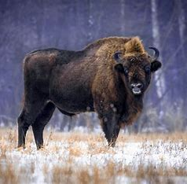
Conclusion
Conclusion: We did not find strong relationships between most of our variables of interest and Bison populations, but we think that we have taken a step toward causal inference with regard to public land share and population decline.
Future Directions:
Examine state-level market prices for bison products.
Analyze urbanization's role in grazing land reduction.
S

Slide 18
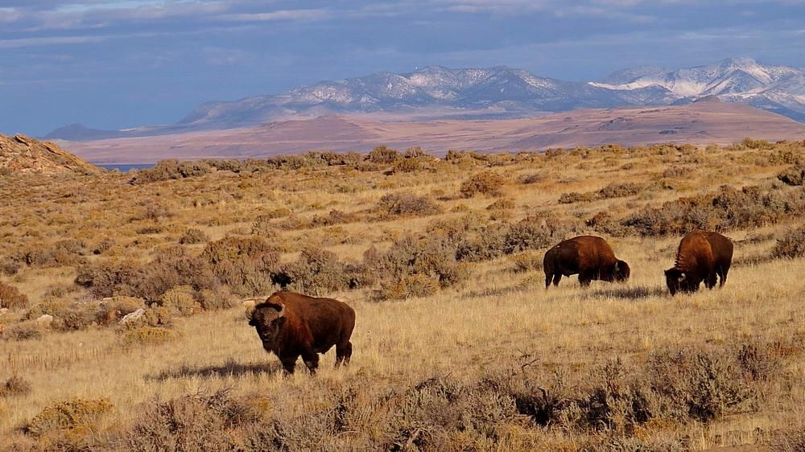
Thanks!

